Slide 1
Sequencing Basics

Slide 2
Three basic problems
Resequencing, counting, and assembly.

Slide 3
1. Resequencing analysis
We know a reference genome, and want to find variants (blue) in a background of errors (red)

Slide 4
2. Counting
We have a reference genome (or transcriptome) and want to estimate gene expression (or something else).

Slide 5
3. Assembly
We don’t have a genome or transcriptome, and we want to construct one.

Slide 7
Outline
Shotgun sequencing
Types of sequencing
Sequencing depth, read length, and coverage
Paired-end sequencing and insert sizes
Basic fastQ data

Slide 8
Shotgun sequencing

Slide 9
An important concept:
Sequencing everything at random (shotgun sequencing) is much easier than sequencing a specific gene region. (For example, it will soon be easier and cheaper to shotgun-sequence all of E. coli then it is to get a single good plasmid sequence.)
Lander-Waterman

Slide 10
Random sampling => deep sampling needed
Typically 10-100x needed for robust recovery (300 Gbp for human)

Slide 11
“Coverage”
“Coverage” is simply the average number of reads that overlap
each true base in genome.
Here, the coverage is ~10 – just draw a line straight down from the top through all of the reads.

Slide 12
What goes wrong with basic assumptions?
Not all sequence is as easily sequenced as other, depending on your sequencing technology (e.g. GC/AT bias);
Some RNA not be as accessible as others (secondary structure);

Slide 13
Types of sequencing available
Illumina
PacBio
Oxford Nanopore
Ion Torrent
Others??
https://flxlexblog.wordpress.com/2016/07/08/developments-in-high-throughput-sequencing-july-2016-edition/

Slide 14
Illumina basics
Short reads
50-500
Lots of them
Billions
Cheap
1k human genome

Slide 15
A movie of Illumina sequencing:
https://www.youtube.com/watch?v=tuD-ST5B3QA#t=61

Slide 16
PacBio basics
Long
20-60kb
Fewer
Few hundred thousand
Expensive
25k human genome

Slide 18
ONT basics
Long
As long as the DNA molecule (in theory)
Few
Very.. Like really only feasible for microbes
Note: Nick Loman and Ebola, Zika..
Expensive
??

Slide 20
Read length and reconstructability

Slide 21
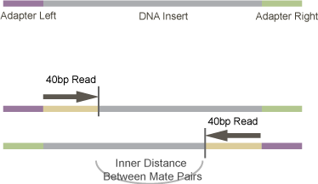
Paired-end sequencing
http://vallandingham.me/RNA_seq_differential_expression.html

Slide 23
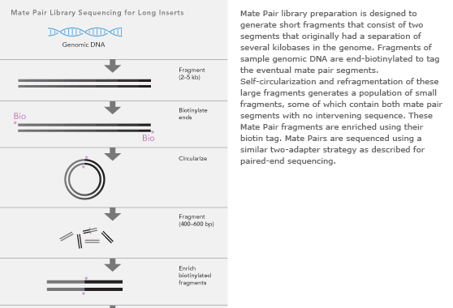
Mate-pair sequencing
(long insert)

Slide 24
Your basic data (FASTQ)
@895:1:1:1246:14654/1
CAGGCGCCCACCACCGTGCCCTCCAACCTGATGGT
+
][aaX__aa[`ZUZ[NONNFNNNNNO_____^RQ_
@895:1:1:1246:14654/2
ACTGGGCGTAGACGGTGTCCTCATCGGCACCAGC
+
\UJUWSSV[JQQWNP]]SZ]ZWU^]ZX][^TXR`
@895:1:1:1252:19493/1
CCGGCGTGGTTGGTGAGGTCACTGAGCTTCATGTC
+
OOOKONNNNN__`R]O[TGTRSY[IUZ]]]__X__

Slide 25
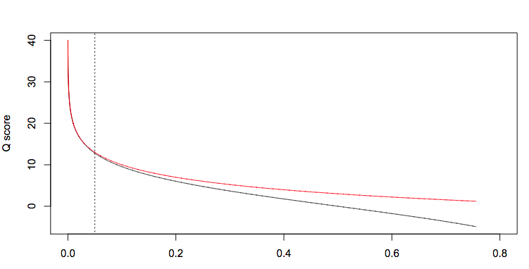

Slide 26
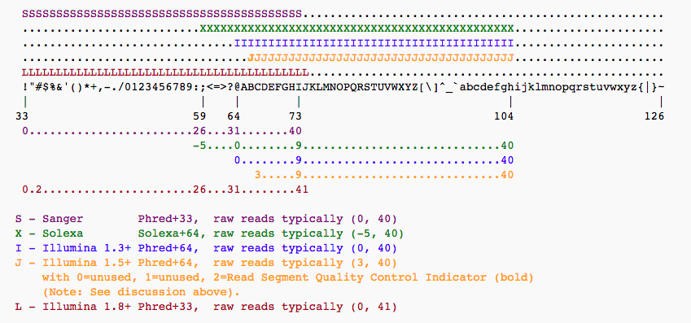

Slide 27
Summary
Coverage matters for SNP calls and assembly;
# of reads matters for counting;
Length of reads matters for reconstructability (assembly & haplotyping);
Illumina is still “best” for high coverage;
PacBio and Moleculo => genome assembly;
Nanopore: still tricky but lots of progress being made.

Slide 28
Later this week --
Many different approaches to evaluating quality/mismatches:
Quality-score based (FastQC etc)
Composition based (FastQC etc)
Reference based (“I know what the answer should look like”)
Assembly-graph / k-mer based

